Slide 1



Nanocomposite Organic Scintillators for PET Imaging
Declan Mahony, James Keaveney, Mark Blumenthal

Slide 2
Outline
Context
How scintillators work
What makes a good scintillator
Scintillator landscape
Motivation for nanocomposites
Progress and Challenges

Slide 3
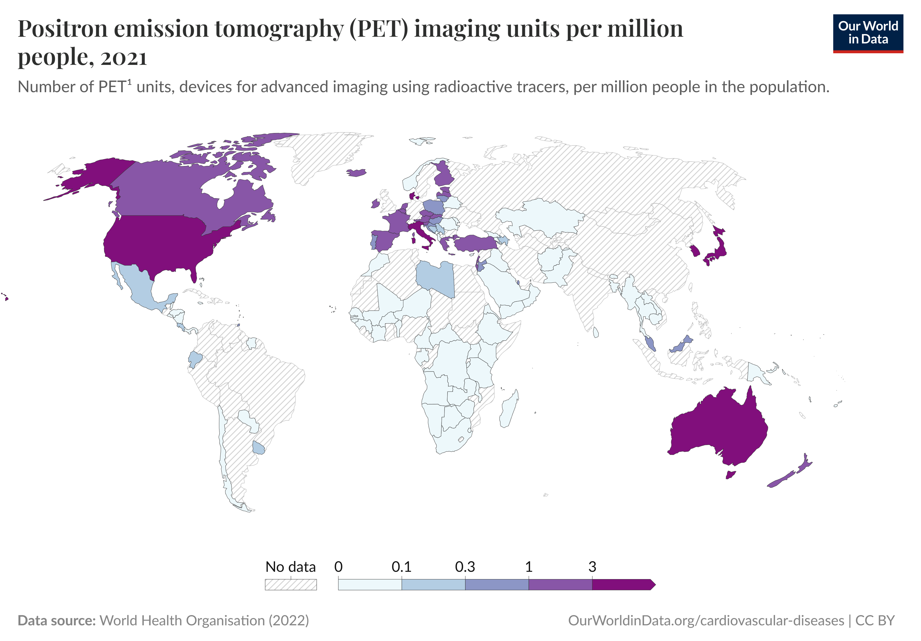
The Big Question
How do we make PET cheaper and more accessible?
Make cheaper scintillators?
Notes:
Why are they expensive?
How can we make them cheaper?

Slide 4
What scintillators do
Detection
Transmission
Processing
Notes:
In this case, we are “seeing” gamma rays

Slide 5






How scintillators work
$$e$$
$$e$$
$$e$$
$$h$$
$$h$$
$$h$$
Absorption
Energy Transfer
Luminescence
Notes:
Talk about the excitation and decay of electrons (excitons) here.

Slide 6
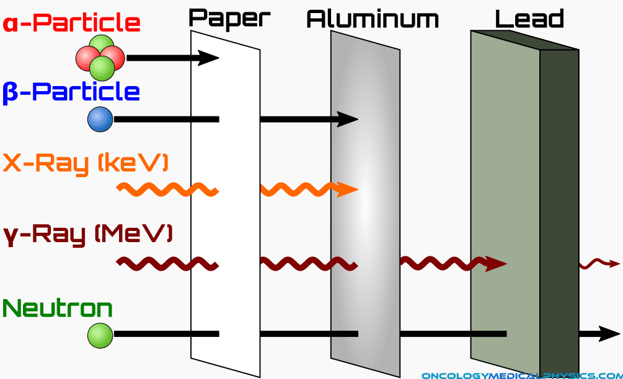

Stopping $γ$ photons is not trivial
How scintillators work

Slide 7




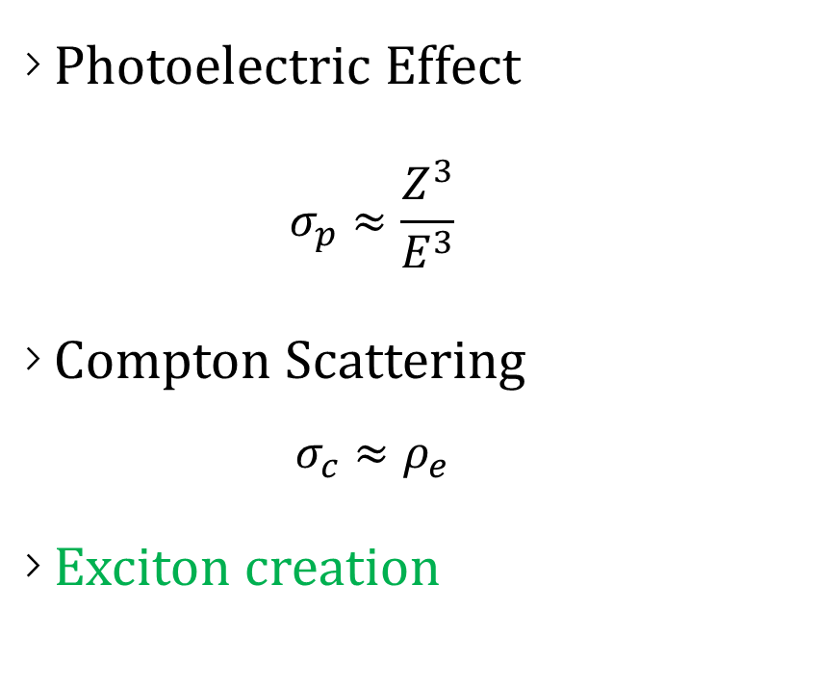
















Absorption
How scintillators work
Photoelectric Effect
$$σ_{p}≈\frac{Z^{3}}{E^{3}}$$
Compton Scattering
$$σ_{c}≈ρ_{e}$$
Exciton creation
Conduction Band
$$e$$
$$e$$
$$e$$
$$e$$
n
n
n
p
$$e$$
p
p
n
$$e$$
p
n
n
n
p
p
p
n
p
$$e$$
$$e$$
$$e$$
$$e$$
$$e$$
$$e$$
$$e$$
n
n
n
p
$$e$$
$$e$$
p
p
n
$$e$$
p
n
n
n
p
p
p
n
p
$$e$$
$$e$$
$$e$$
$$e$$
Valence Band

Slide 8





















Absorption
How scintillators work
Secondary scatters
$γ$ energy depletion
Exciton cascade
Conduction Band
$$e$$
$$e$$
$$e$$
$$e$$
n
n
n
p
$$e$$
p
p
n
p
n
n
n
$$e$$
p
p
p
n
p
$$e$$
$$e$$
$$e$$
$$e$$
$$e$$
$$e$$
$$e$$
$$e$$
$$e$$
$$e$$
$$e$$
n
n
n
p
$$e$$
$$e$$
p
p
$$e$$
n
n
n
p
p
n
n
n
n
p
p
p
$$e$$
p
p
n
$$e$$
p
n
p
n
n
n
p
p
p
$$e$$
$$e$$
$$e$$
n
p
$$e$$
$$e$$
$$e$$
$$e$$
$$e$$
Valence Band

Slide 9










Energy Transfer
How scintillators work
Non-radiative excitation of active centers
Exciton recombination
Lattice vibrations (heat)
Förster/Dexter energy transfer
Host Matrix
Detector
Defect
Active center
$$e$$
$$e$$
$$e$$
$$h$$
$$e$$
$$h$$
$$e$$
$$h$$
$$e$$
$$h$$
$$h$$
$$h$$
Phonon

Slide 10
Luminescence
How scintillators work
Relaxation of active centers.
Photon emission.
Transmitted out.
Host Matrix
Detector
Defect
Active center
$$e$$
$$e$$
$$e$$
$$h$$
$$e$$
$$h$$
$$e$$
$$h$$
$$e$$
$$h$$
$$h$$
$$h$$
Phonon
Photon

Slide 11
Losses
How scintillators work
Phonon emission
Self-absorption
Scattering
Host Matrix
Detector
Self-absorption
Phonon
$$e$$
$$e$$
$$e$$
$$h$$
$$e$$
$$h$$
$$e$$
$$h$$
$$e$$
$$h$$
$$h$$
$$h$$
Scattering

Slide 12
What makes a good scintillator
Light Yield
Fast Scintillation
Energy Resolution

Slide 13
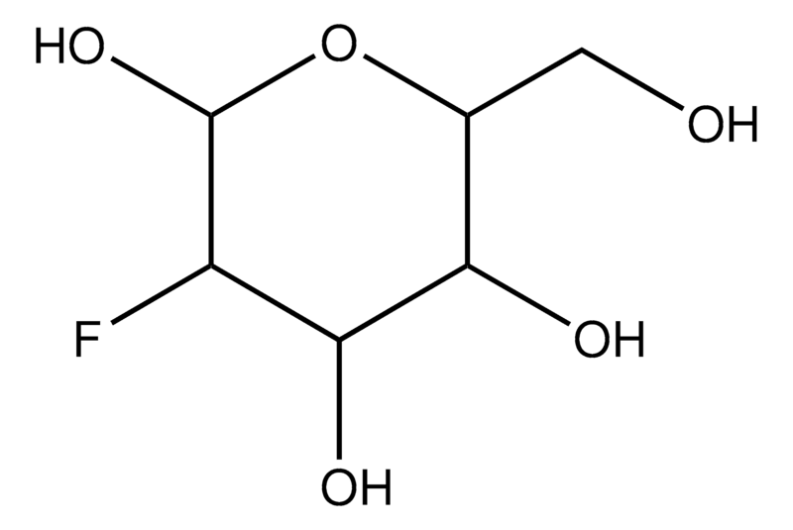
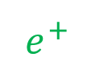
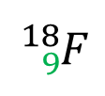
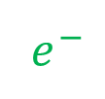



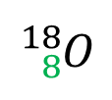
Recap
What makes a good scintillator
See the $γ→$ see the tumour
$e^{+}$
Fluorodeoxyglucose
$$511 keV$$
n
p
n
n
p
n
n
p
p
p
n
p
p
n
p
p
$e^{−}$
n
n
n
n
n
n
p
p
p
p
p
p
n
p
n
p
$$511 keV$$
${}_{8}^{18}O$
${}_{9}^{18}F$

Slide 14
What makes a good scintillator
Noisy complications

Slide 15
What makes a good scintillator
Noise Elimination
Add another camera
Coincidence timing
Fast scintillation

Slide 16
What makes a good scintillator
Noise Elimination
Add another camera
Coincidence timing
Fast scintillation
Filter by Energy
Photopeak identification
Energy resolution

Slide 17
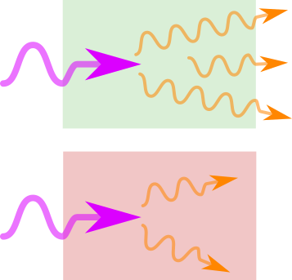
Light Yield
What makes a good scintillator
High stopping power
Density
Atomic number
High transparency
Low self-absorption
Minimal scattering

Slide 18
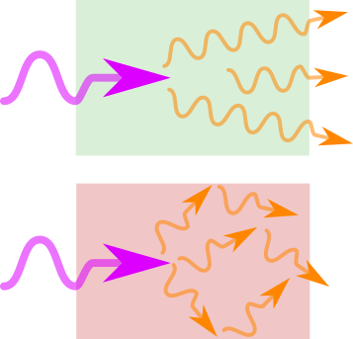
Fast scintillation
What makes a good scintillator
Fast exciton decay
Short recombination length
Concentrated active centers
Efficient FRET/DET
Minimal energy transfer paths
Strong quantum resonance

Slide 19
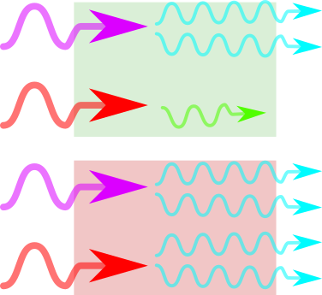
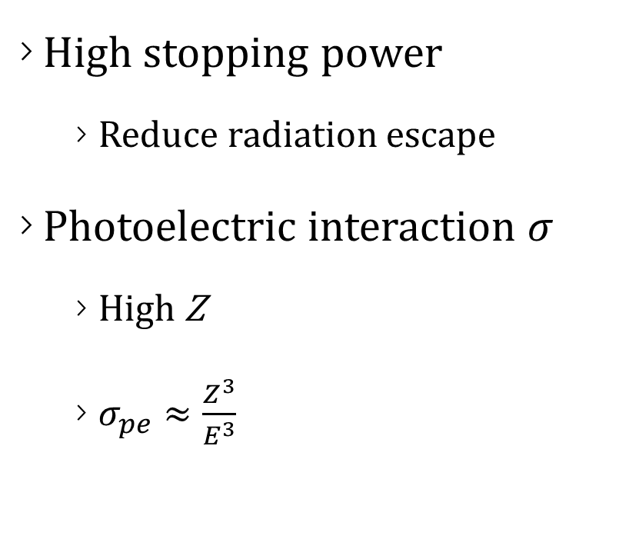
Energy Resolution
What makes a good scintillator
High stopping power
Reduce radiation escape
Photoelectric interaction $σ$
High Z
$σ_{pe}≈\frac{Z^{3}}{E^{3}}$

Slide 20
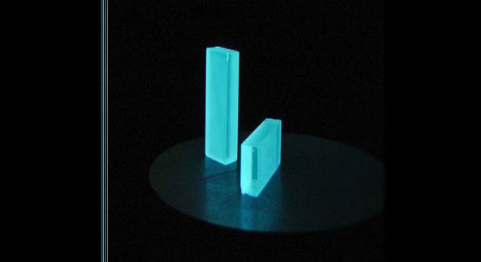
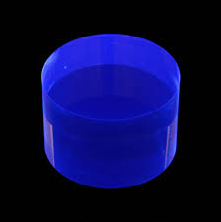
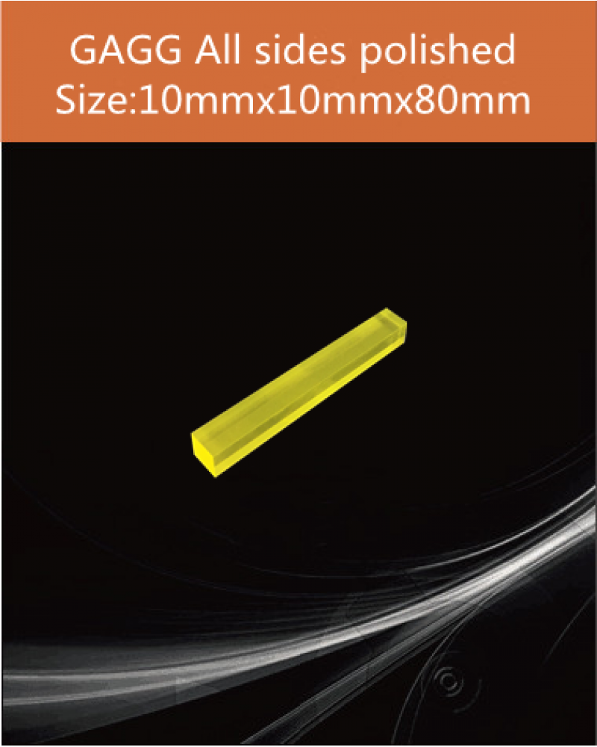
Scintillator Landscape
Crystals
Organics
Ceramics

Slide 21
Crystals
Scintillator Landscape
Stopping power – 1 cm attenuation (high Z)
Energy resolution – photoelectric events
Fast scintillation – 40 ns decay time
Transparent – 32 000 photons/MeV light yield
Expensive

Slide 22
Organics
Scintillator Landscape
Stopping power – 10 cm attenuation (low Z)
Energy resolution – NO photoelectric events
Fast scintillation – 2 ns decay time
Transparent – 10 000 photons/MeV light yield
Expensive

Slide 23
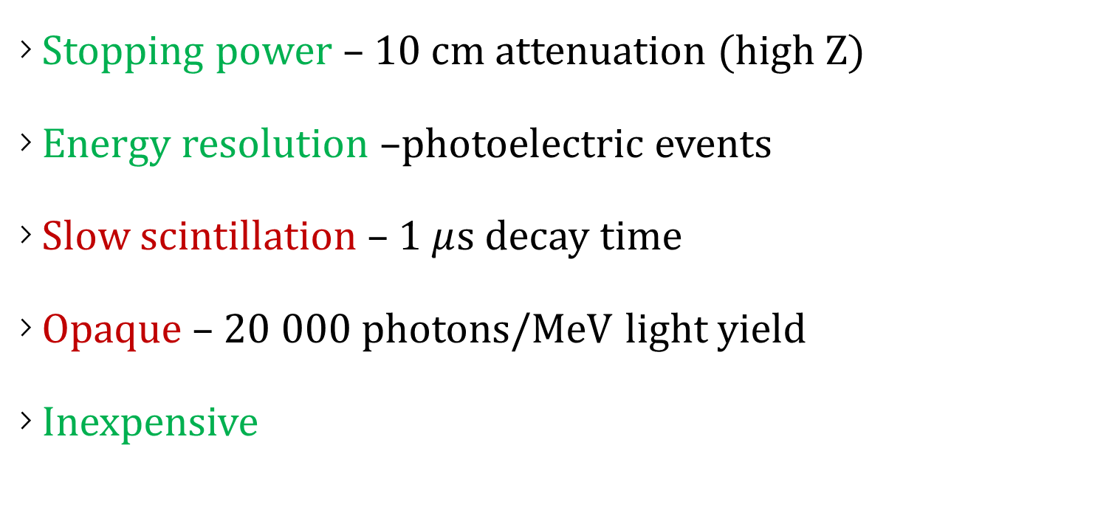
Ceramics
Scintillator Landscape
Stopping power – 10 cm attenuation (high Z)
Energy resolution –photoelectric events
Slow scintillation – 1 $μ$s decay time
Opaque – 20 000 photons/MeV light yield
Inexpensive

Slide 24
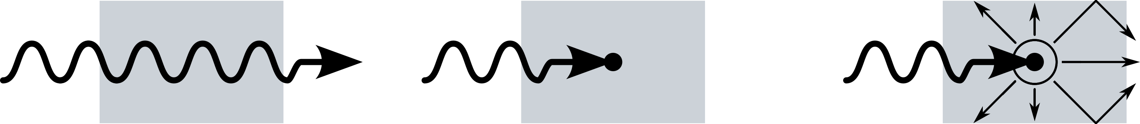
Motivation for Nanocomposites
Cheap polymer host matrix
Small, dense activation centres
Fast scintillation

Slide 25

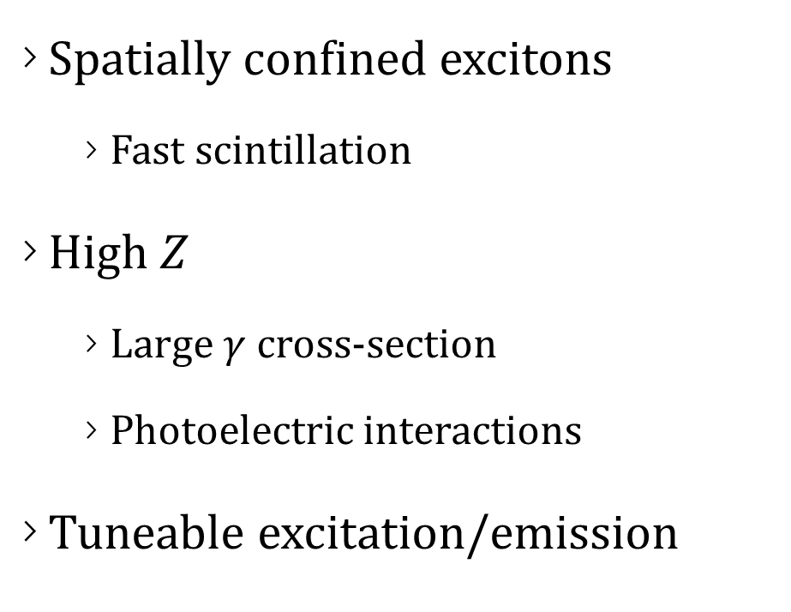




Nanoparticle Activation Centers
Motivation for Nanocomposites
Spatially confined excitons
Fast scintillation
High $Z$
Large $γ$ cross-section
Photoelectric interactions
Tuneable excitation/emission
Host Matrix
$$e$$
$$e$$
$γ$
$$h$$
$$h$$

Slide 26
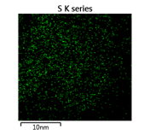
Nanocomposite plastic
Motivation for Nanocomposites
Stopping power – High Z
Energy resolution –photoelectric events
Fast scintillation – 1 ns decay time
Transparent? – High self-absorption and scattering
Inexpensive?

Slide 27

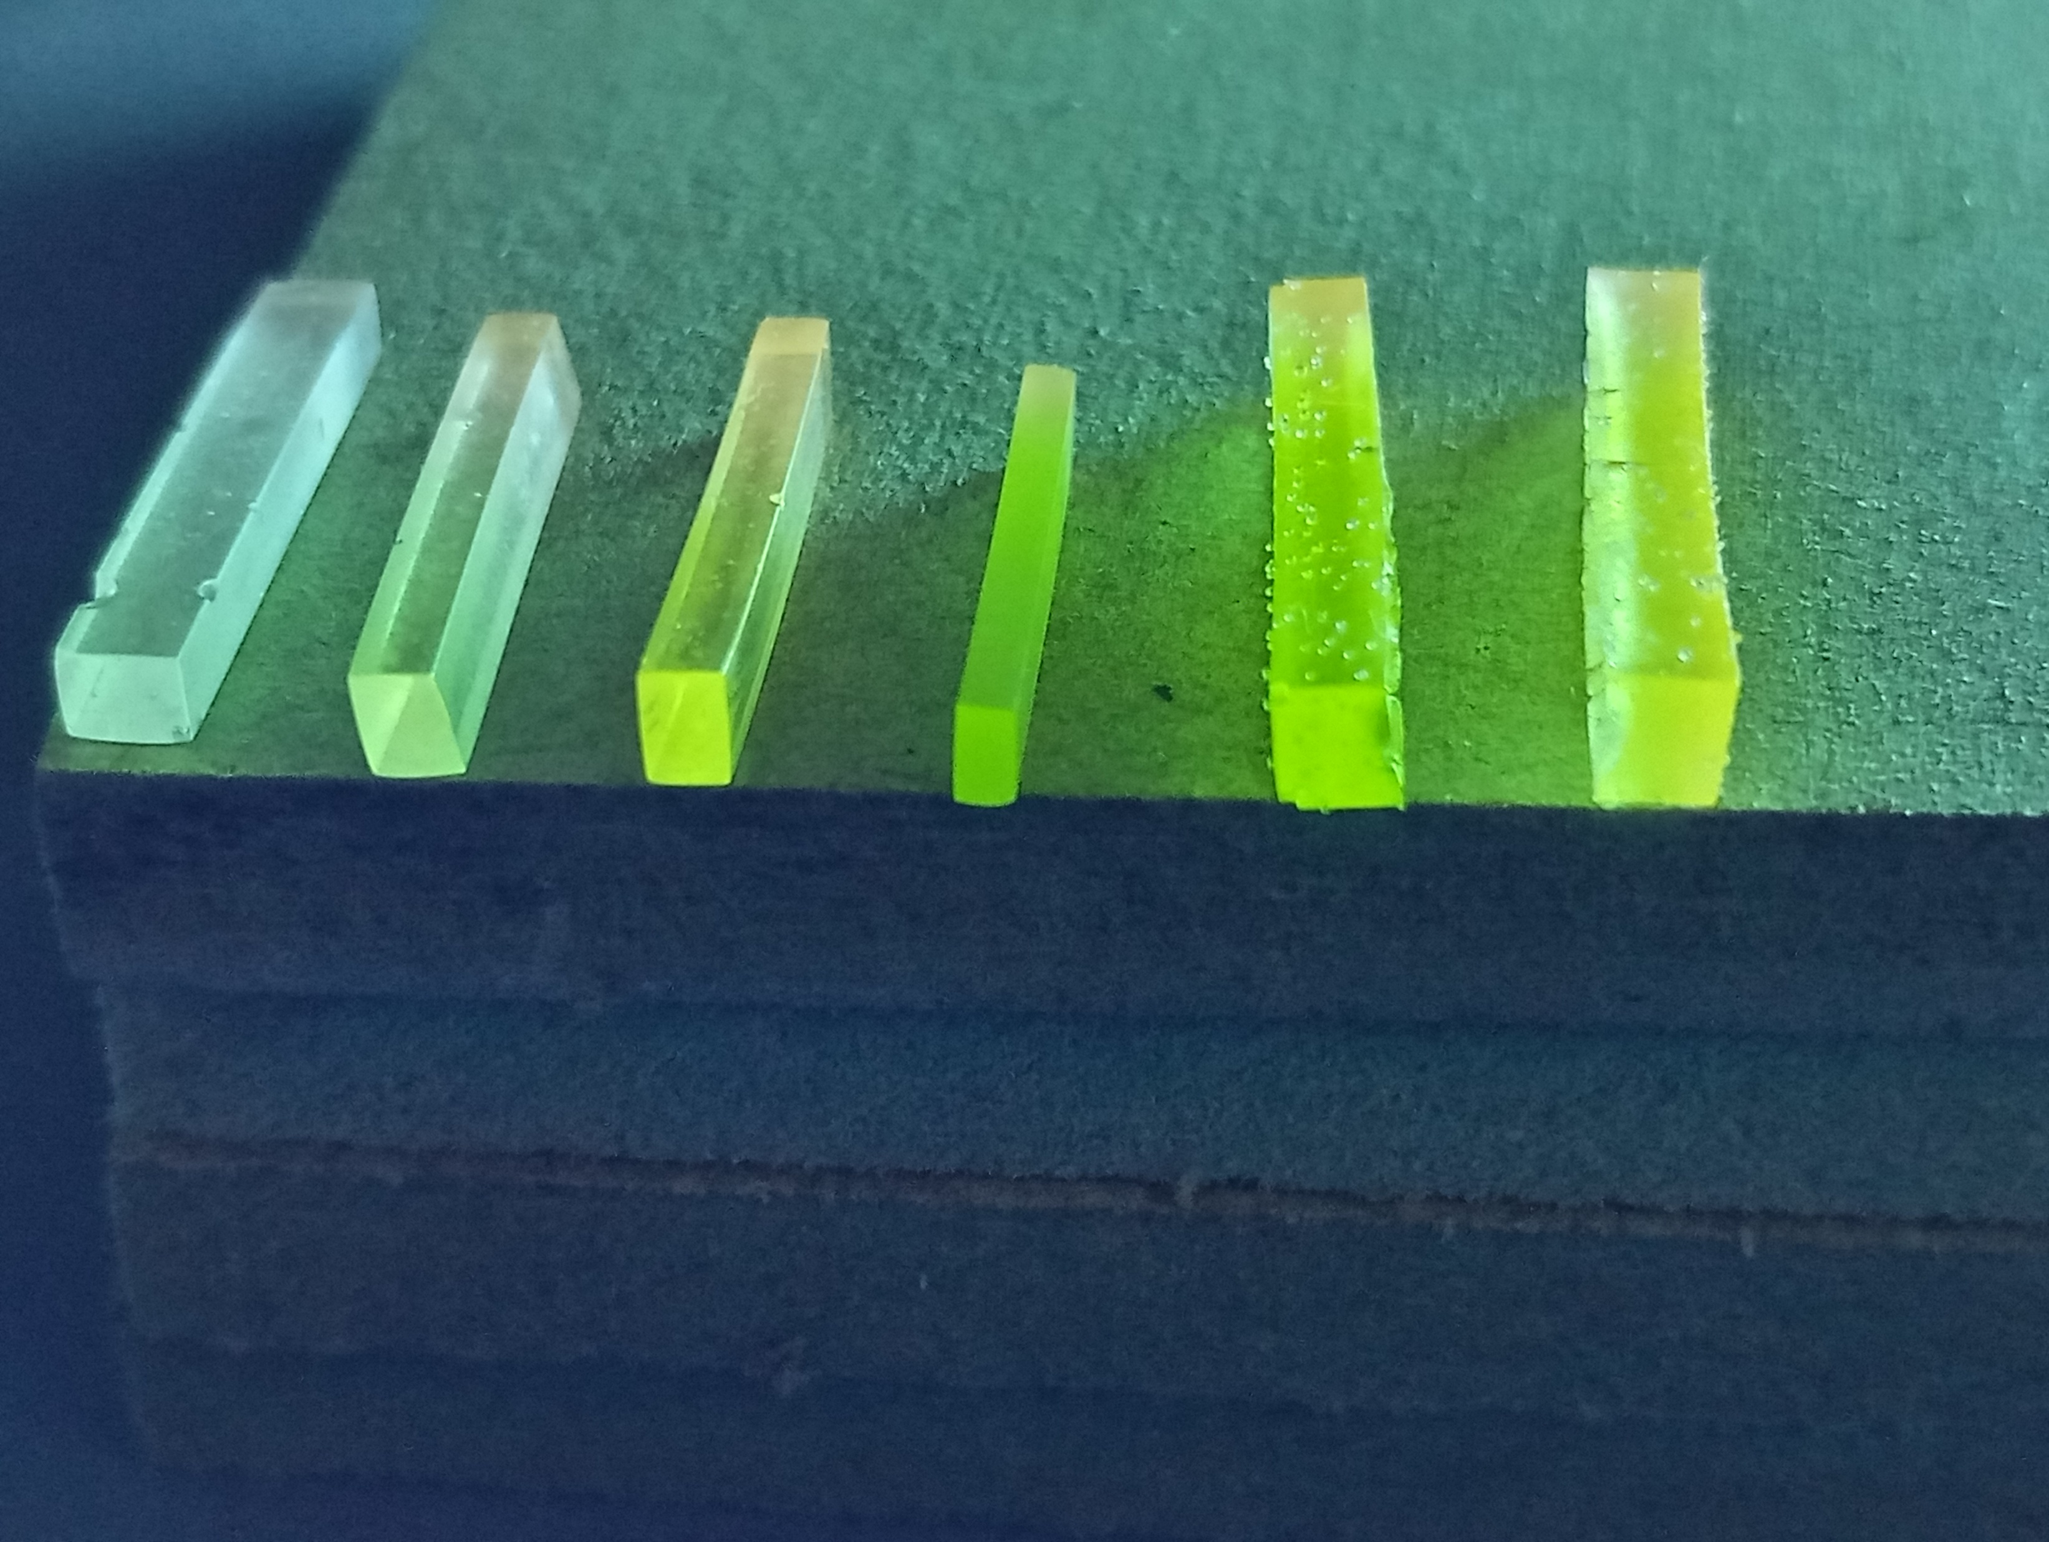
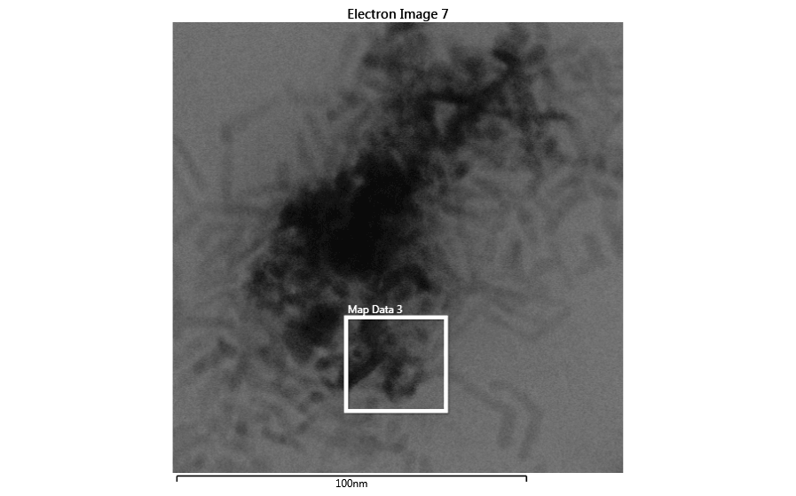
Trial #1 – Epoxy Resin + CdS Nanoplatelets
0.05
0.10
0.20
0.30
0.40
0.60
Wt. % CdS

Slide 28
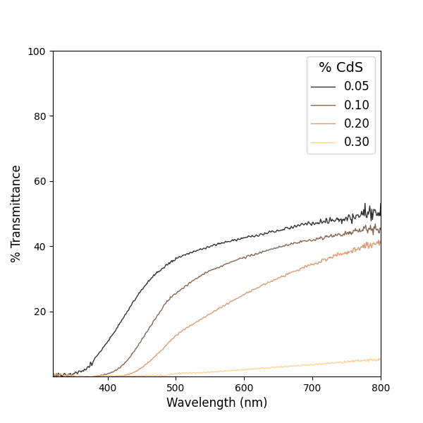
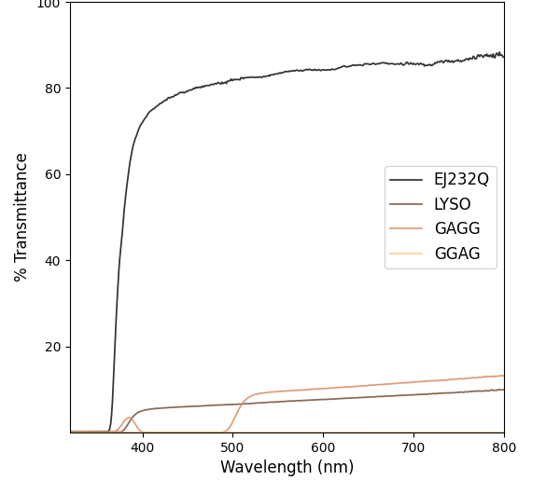
Transmittance
Trial#1

Slide 29
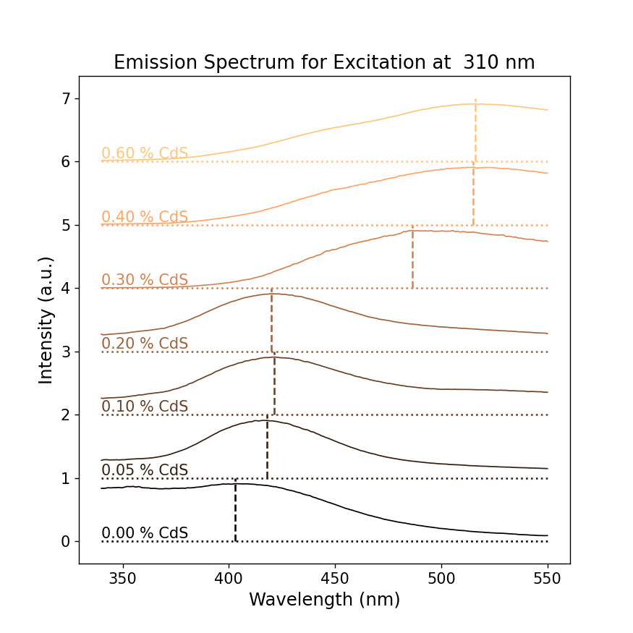
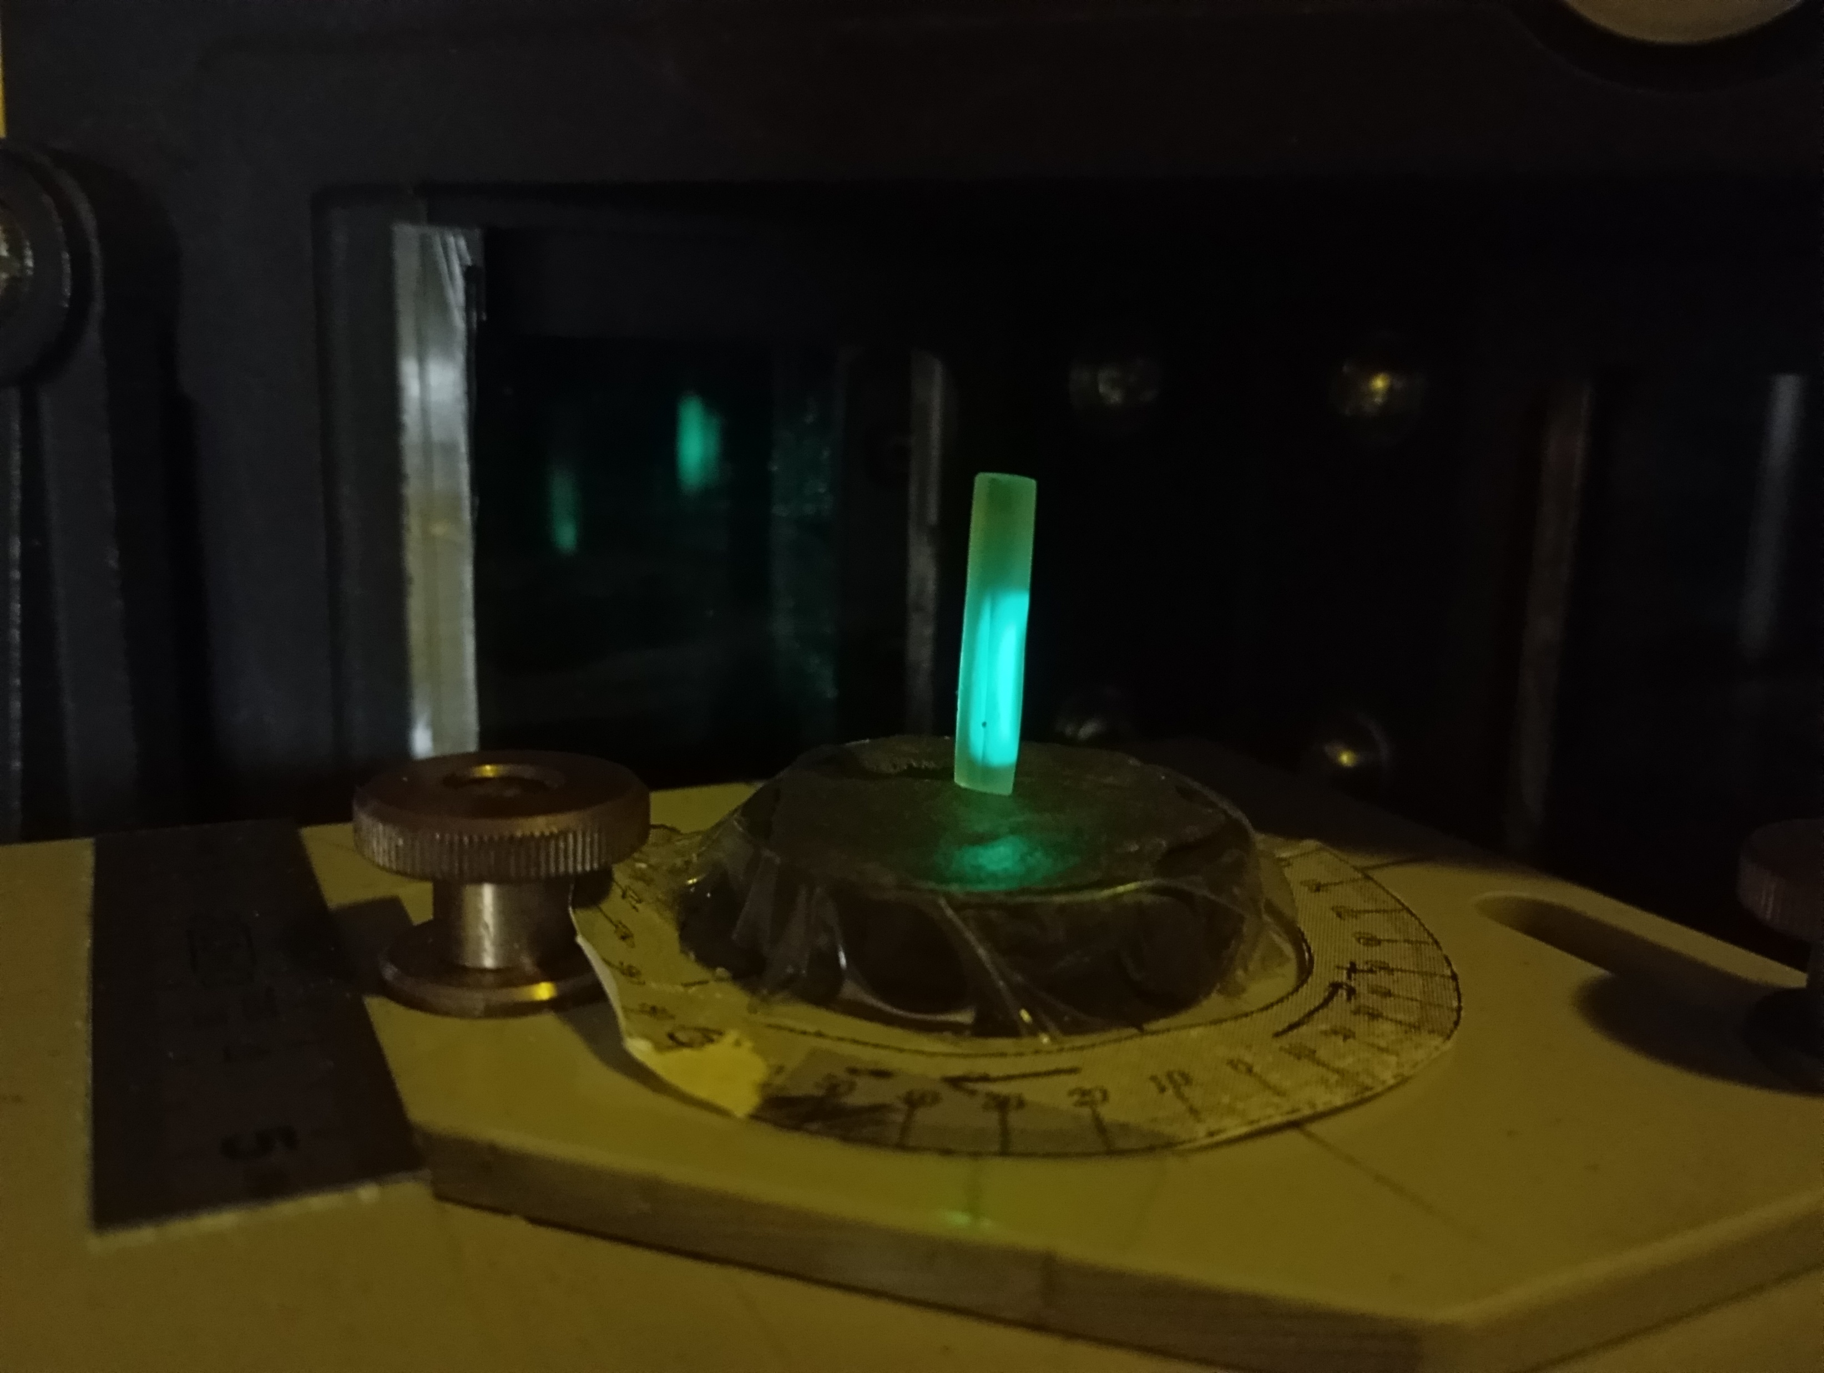
Photoluminescence
Trial#1

Slide 30
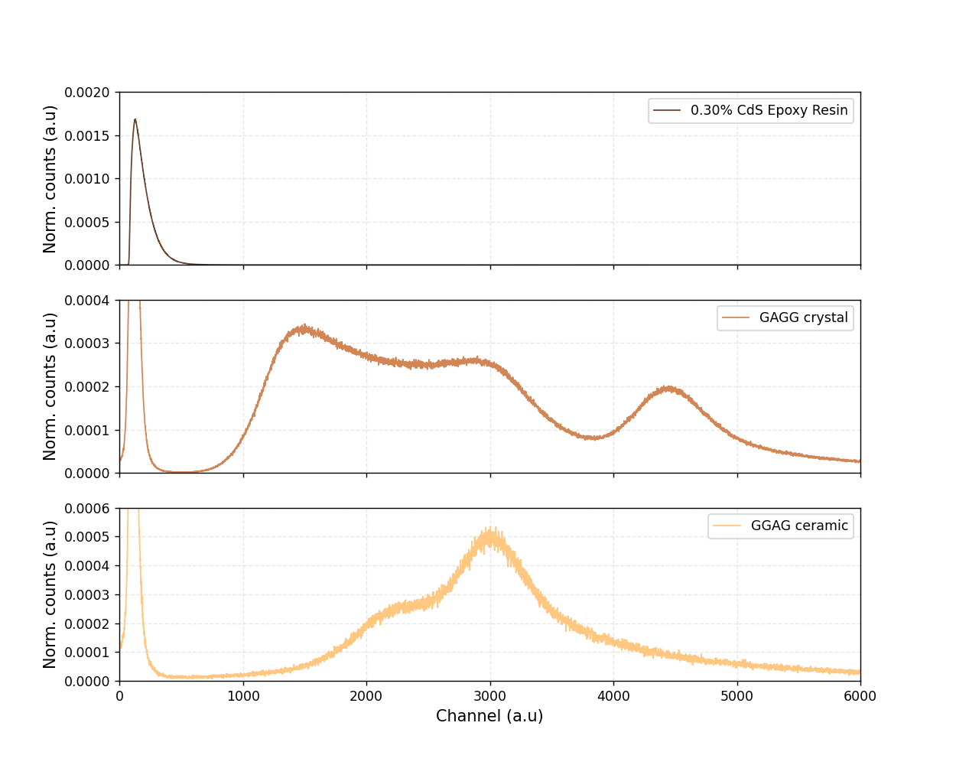
Light Yield
Trial#1

Slide 31
Problems and Potential Solutions
Trial#1
Low transmittance
Nanoparticle aggregation
Poor polymer integration
Low light yield
Inefficient energy transfer
Inadequate active centers
High self absorption
Surface Ligand Exchange
Co-polymerizable coupling agents
Mitigate defect formation
Conventional dopants
Secondary active centers – PPO
Wavelength shifter - POPOP

Slide 32
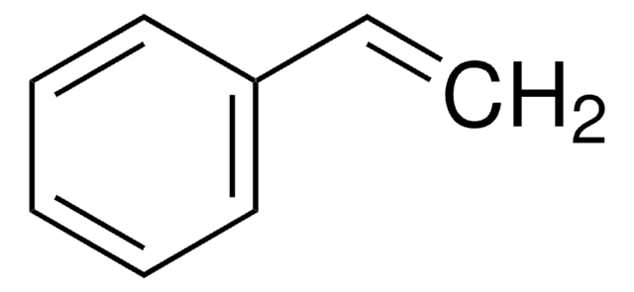
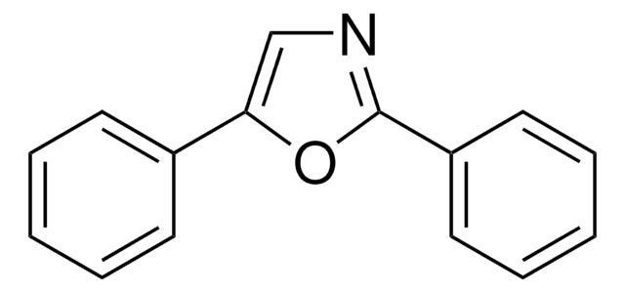
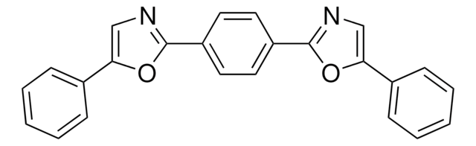
Trial #2 – Conventional Polystyrene
Styrene
2,5-Diphenyloxazole (PPO)
1,4-Bis(5-phenyl-2-oxazolyl)benzene (POPOP)

Slide 33
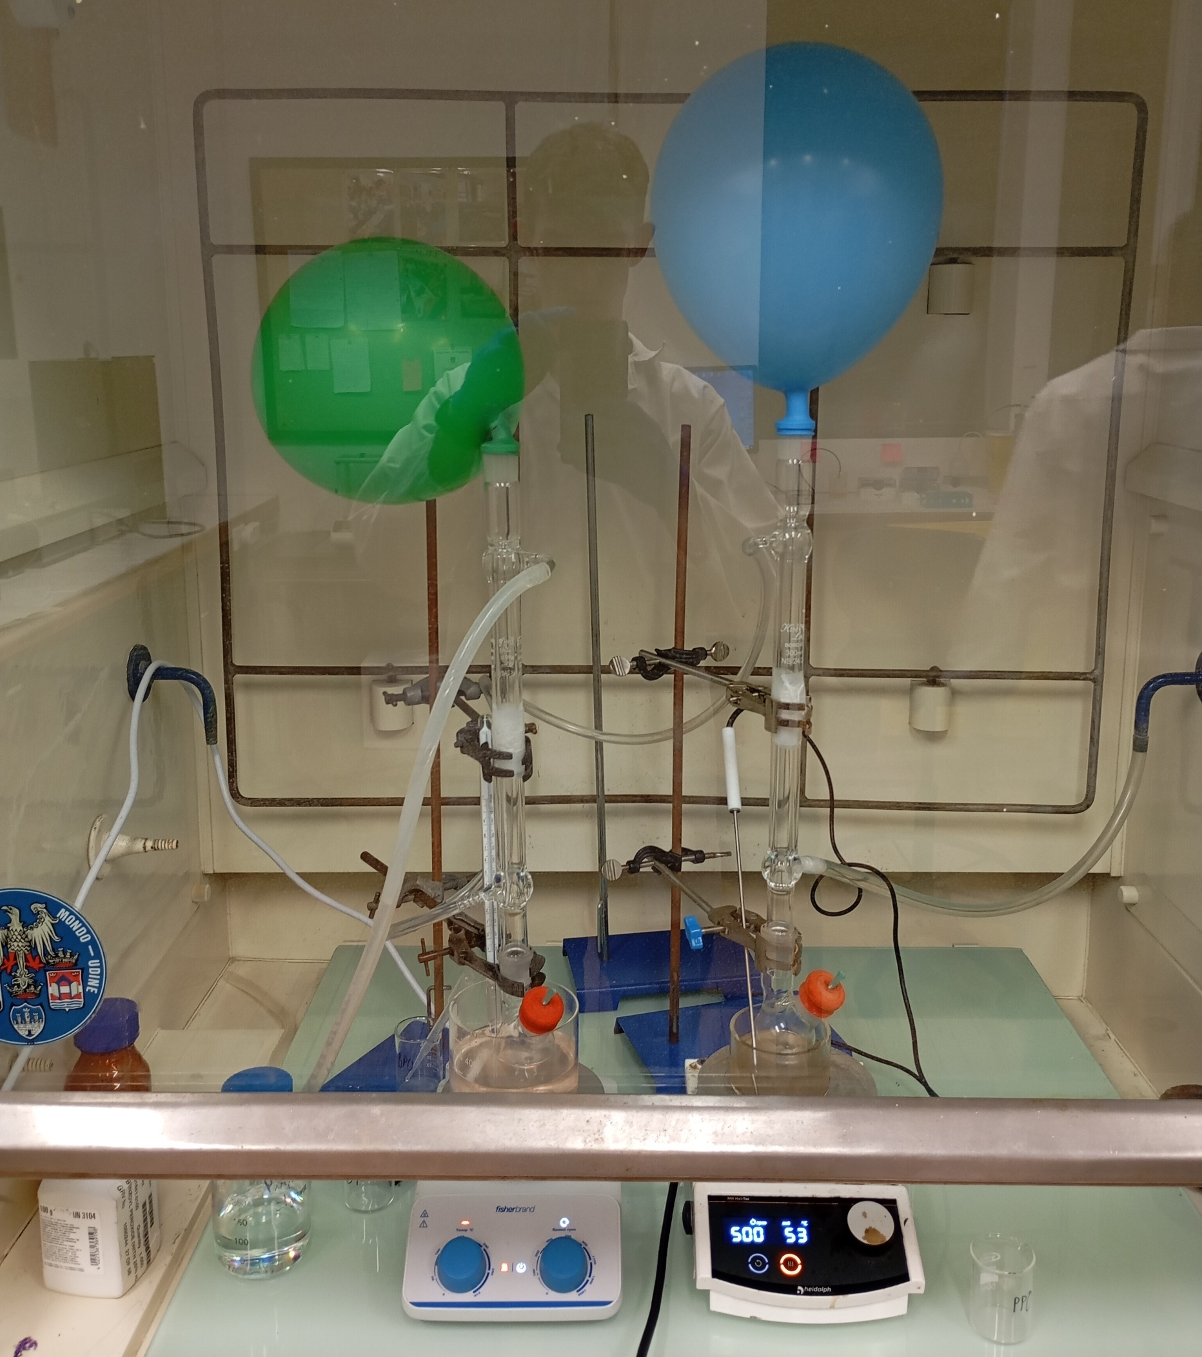
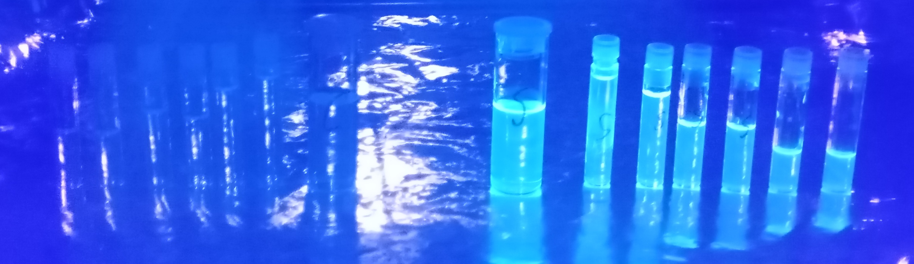
Trial #2 – Conventional Polystyrene
Styrene
PPO
POPOP

Slide 34
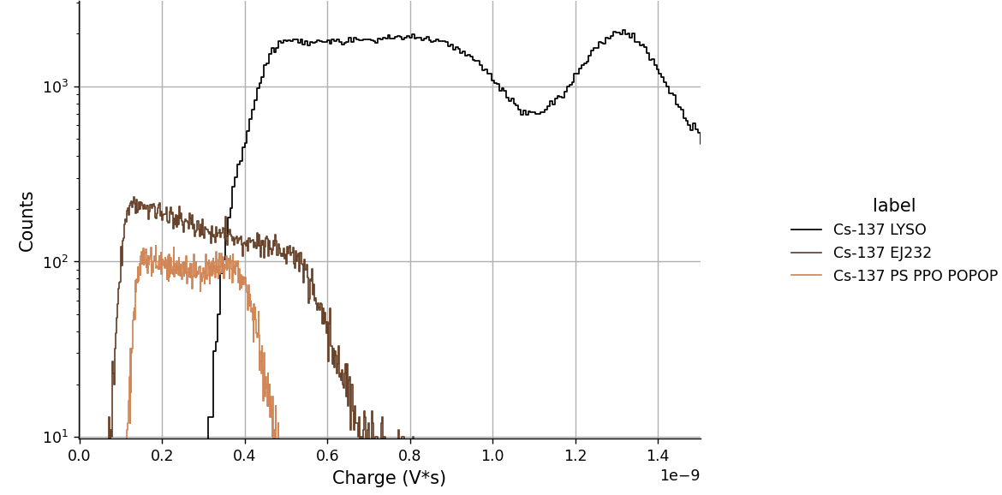
Energy spectrum
Trial#2

Slide 35
Trial #3 – Add CdSe nanoparticles

Slide 36
Thank you!

